Slide 1



Notes:
Introduction by Cash
Hello, I’m Alex Cash, I’ve never genuinely smiled in my life and I hate my team. The reason I’m so good at strawpedos is because of all the cock I devour on a weekly basis.

Slide 2

Who Are We?

Slide 3

Technology in Education
Widely available and used in schools
PC, interactive whiteboards, smart phones & tablets
Lesson plans, interactive games, class content and Multimedia
Motivates, improves attitudes towards education & effective progress tracking
Higher level of achievement
Notes:
In todays society people everywhere use technology, and education is no different. In recent years technology in schools has grown significantly, which has lead to the use of several different types of devices. The most commonly used are PCs, interactive whiteboards & tablets. They are used to reinforce and expand the already available content in the schools syllabus, by way of the teaching applications available; these are generally digital lesson plans, interactive educational games and multimedia. From surveys found online [mashable] and our own marketing department, the teachers who use these methods have found that it motivates their students more and improves their overall attitude towards learning. It has also made it easier for teachers to help students visualise a concept explained in lesson by using videos and images. This leads to a greater understanding of the topic for students and hence a higher achievement in school.

Slide 4
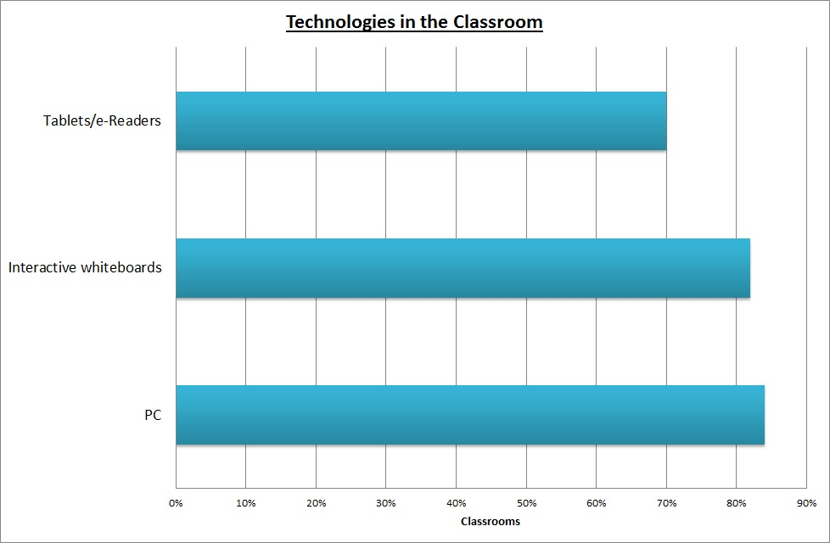
Technology in Education
Notes:
This graph shows that there is no lack of technology in schools. At least 75% of schools have access to these three main types of technology. PC being the most available.

Slide 5
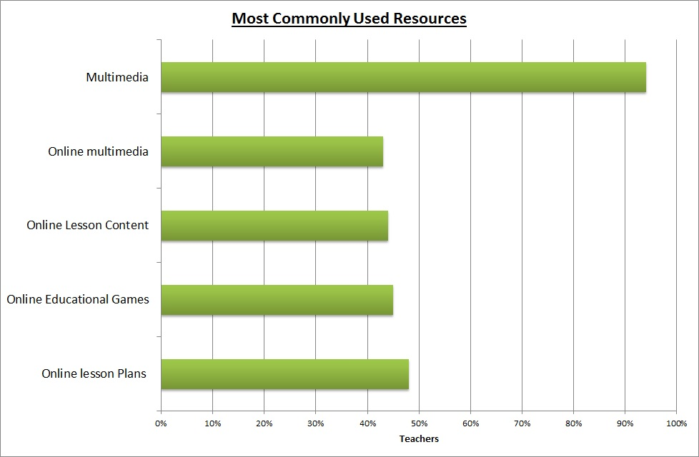
Technology in Education
Notes:
This graph shows how the available technologies are most commonly used in the classroom. 94% of teachers use some form of multimedia to reinforce their lessons and nearly half of the teachers plan lessons and provide content online.
This shows that teachers are actively using the resources available in the classroom and implies a demand for educational software such as learning aid applications.

Slide 6
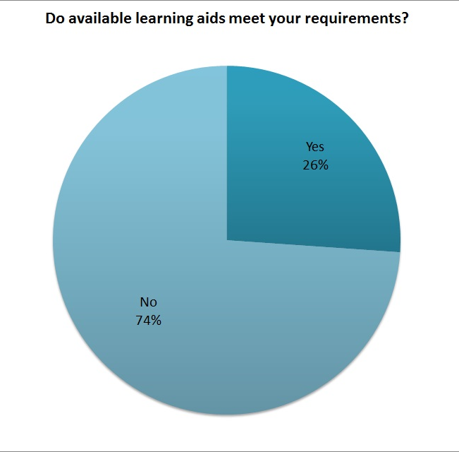
Technology in Education
Notes:
Encouraged from the statistics in the previous slide, a survey was done to prove the implied demand. A number of teachers were specifically asked if the available learning aid software currently meets their requirements; 74% said no. The same group was also asked if they would use a piece of software that would satisfy those needs; 74% said yes. Providing valuable information on the issues faced by teachers using the current resources, which demonstrates a real demand for this type of software.

Slide 7




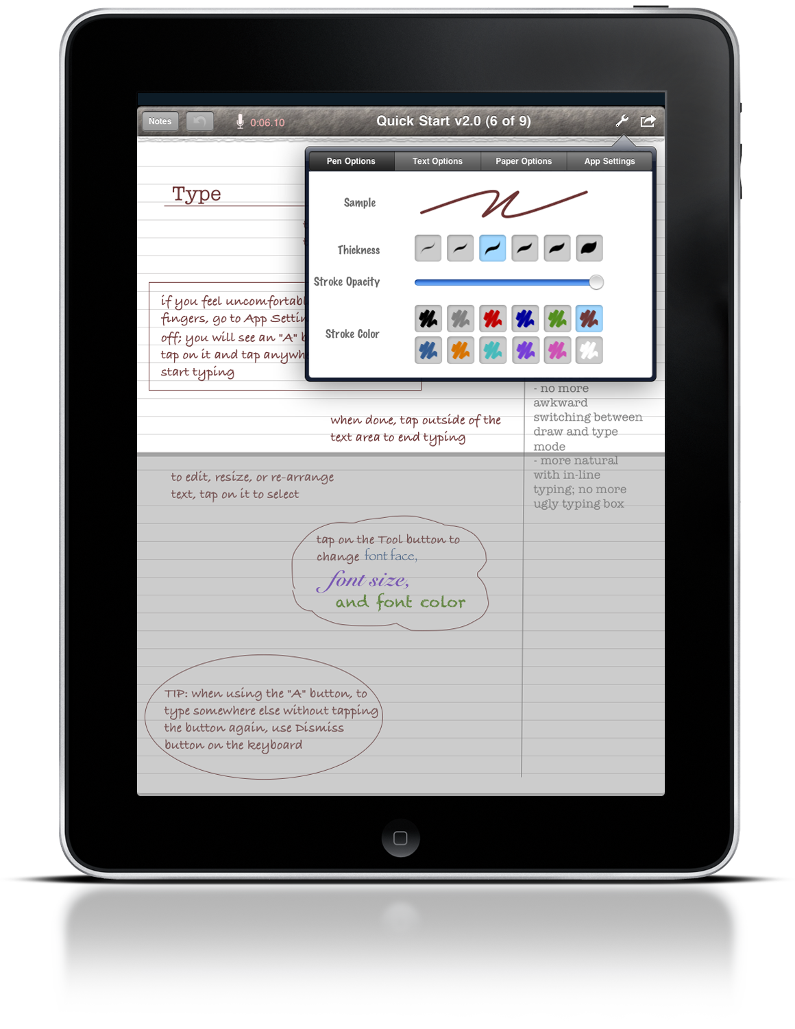
Common Classroom Technology
Hardware | Software
Notes:
*Add animations and stuff when we know what we’re talking about.
There are many pieces of software that have taken advantage of the available hardware in education to meet some of these issues faced by teachers.
These most commonly used are: Doddle, MyMaths and Microsoft PowerPoint

Slide 8
Currently used in 31% of schools
Provides large number of pre-made syllabus content
Limitations include
Expensive
Non-Customisable
£6,900
Notes:
Doddle is a pre-made content driven piece of software.
The material spans across 19 different subjects.
It costs £6900 for the suite package which will give access to nearly all of the subjects. Or you can purchase individual lesson content which ranges from £400 to £999. and this is per year per school.
The limitations of doddle are:
- Expensive
- It can only be used for assessments
- Non Customisable (prepare for this question)
- Only online based

Slide 9
One of the most popular educational software programs used, 60% of secondary schools
Provides pre-made homework starting from primary school through to secondary school
From mumsnet.com
“Child can’t go back and retake if they get it wrong”
“Questions are ambiguous and lack explanation”
£265/565
Notes:
MyMaths is again, pre-made content driven software specialising in maths. The price is simply split into three categories: £265 for primary, and £565 for either the Secondary material or post 16 level, which is per year per school.
The limitations of Mymaths are:
- Restricted to just maths
- Only used for assessment
- The Questions are non retriable
- Online based

Slide 10
6 million teachers use powerpoint worldwide
Can be used to create information rich slides
In schools the predominant use is for lessons
No interactive elements
Notes:
PowerPoint for those of you who don’t know, is a tool used to create and show user customised content. Teachers use it to create informative material for lessons and revision.
Limitations:
- Can be edited by the recipient
- Not interactive

Slide 11
The Problem
“Cognitive research has shown that learning is most effective when four critical characteristics are present:
1. Active participation
2. Group participation
3. Immediate feedback
4. Real world connections”
- Julia Catherine Weathersbee, Texas State University
Software
Teacher
Notes:
This is an interesting quote from a research paper that states that learning is most effective when these four
critical characteristics are present.
Active participation can be improved through the use of software. By making the lesson interactive and
more entertaining.
Immediate feedback can also be improved through software. A study [1] on the benefits of quicker feedback had found that students who received it sooner rather than a few days or weeks, showed a significant increase in
performance and software would give a near instantaneous response.
However the teacher aspect is still needed to enable group participation and real world connections. (prepare question)

Slide 12
Pre-made maths content
Pre-made Syllabus content
Make lessons from scratch
More like tests
Don’t cater to tutors
Good for revision/presenting
Customisable
Notes:
MyMaths & Doddle improve active participation and allow immediate feedback. Where as powerpoint has total customisability, and aids the teacher in
group participation.
There currently isn’t software available that combines those factors, so there is a gap in educational applications that needs to be filled.

Slide 13


Information rich
Pushes interactive learning
Automatic feedback
Notes:
Therefore we have developed TeachEasy and LearnEasy, which allow the teacher to fully customise lesson content and implement assessments.
TE provides a platform to create a lesson that can be rich with information as well as tests along the way. This pushes the notion of interactive learning to help students absorb the information presented to them.
LE allows students to view and run through the lessons in a clean, uncomplex user interface where questions are automatically marked.
Important: This also provides the opportunity to create lessons that are not strictly curriculum based.

Slide 14
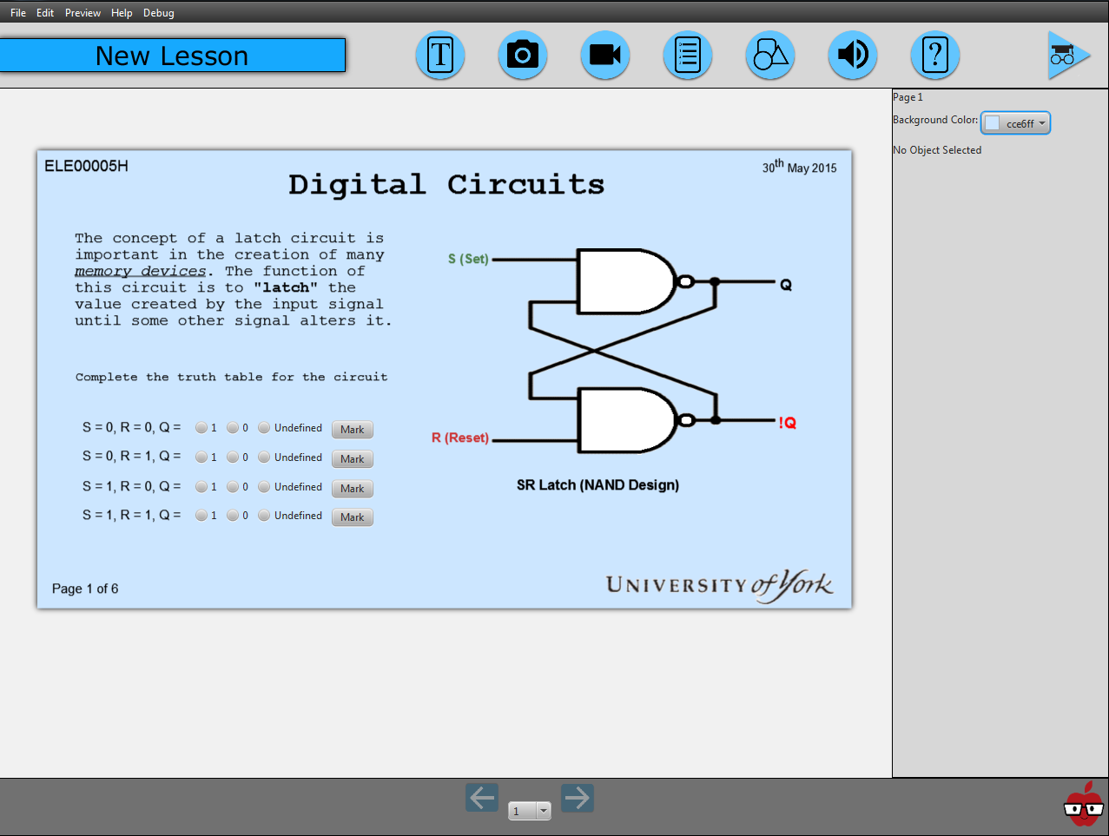

Slide 15
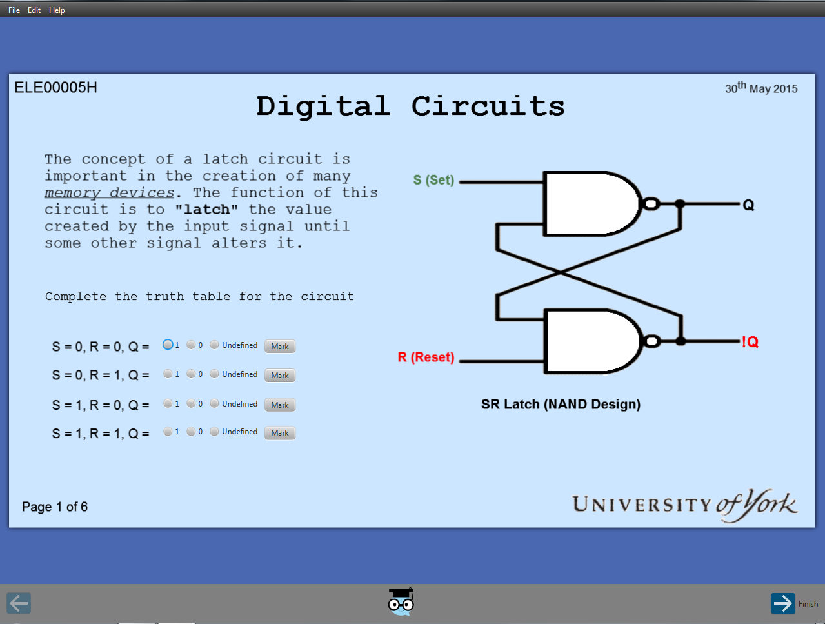

Slide 16
Product
Demonstration

Slide 17
Sales
Strategy

Slide 18
Pricing Per Head per Year
?
?
?
Notes:
Make sure they know we are NOT selling on school by school basis. but prices were approximated on a per school basis.
When pricing our product we decided to opt for a competitive psychological method pricing the product in between competitors, and rounding the result to a psychologically appealing figure

Slide 19
Pricing Per School per Year
£6,900
£265 / £565
£550
Notes:
Make sure they know we are NOT selling on school by school basis. but prices were approximated on a per school basis.
When pricing our product we decided to opt for a competitive psychological method pricing the product in between competitors, and rounding the result to a psychologically appealing figure

Slide 20
Pricing per Head per Year
23,948 UK schools
451,100 teachers
£29.99 per Head
Notes:
Given our figures for the average number of teachers per school, this means we can sell TE for £29.99 per teacher to average £550 per school
Price reassures a decent product, and is cheap enough for an individual tutor
£29.29 exactly

Slide 21
Group Pricing per Head per Year
10% Discount
£26.99 per Head
Notes:
Given our figures for the average number of teachers per school, this means we can sell TE for £29.99 per teacher to average £550 per school
Price reassures a decent product, and is cheap enough for an individual tutor

Slide 22
Pricing per Head per Year
£ FREE
Notes:
Given our figures for the average number of teachers per school, this means we can sell TE for £29.99 per teacher to average £550 per school
Price reassures a decent product, and is cheap enough for an individual tutor
£29.29 exactly

Slide 23
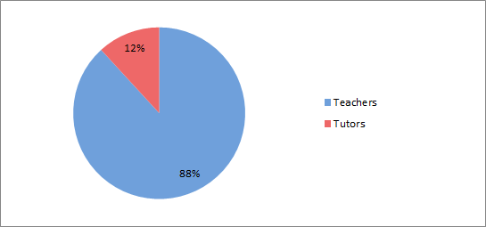
Potential Market Distribution
Notes:
Total distribution of the number of people we designed the product for. We split educators between mainstream school syllabus teachers, and private tutors.

Slide 24
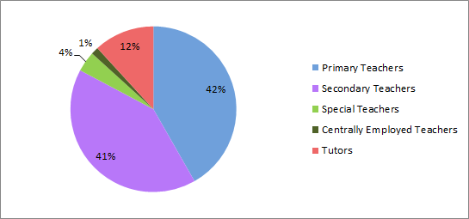
Potential Market Distribution
Notes:
These are the categories defined in government school censuses

Slide 25
Survey Results
73%
of educators asked said they are interested in our product
Notes:
Sample size: 23
Primary Teacher: 4
Secondary Teacher: 3
Private tutor: 13

Slide 26
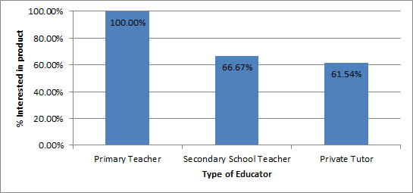
Survey Results
Notes:
22 sample size

Slide 27
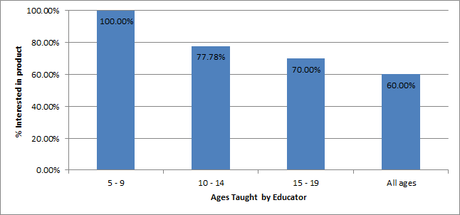
Survey Results
Notes:
23 sample size

Slide 28
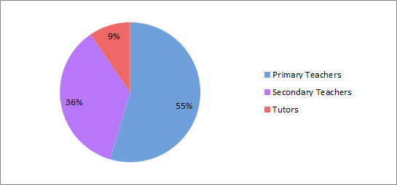
Likely Market Distribution

Slide 29
Market Distributions
Potential Market Distribution
Likely Market Distribution
Notes:
Note: Discount special schools, specialist market.
Main target primary school, yet you dont undercut MyMaths primary

Slide 30


Fixed Cost Advertisement
 | £18,000 | 378,000 Impressions Predicted 3231 Sales per Year
 | Up to £3650 | 60,000 Impressions Improve Brand Awareness Predicted 88 Sales per Year

Slide 31
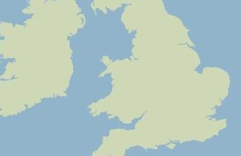




Variable Cost Advertisement
 | £ Labour | Improve Brand Awareness Improve Company Image Increase school sales
 | Free | Improve Brand Awareness Contact with customers

Slide 32
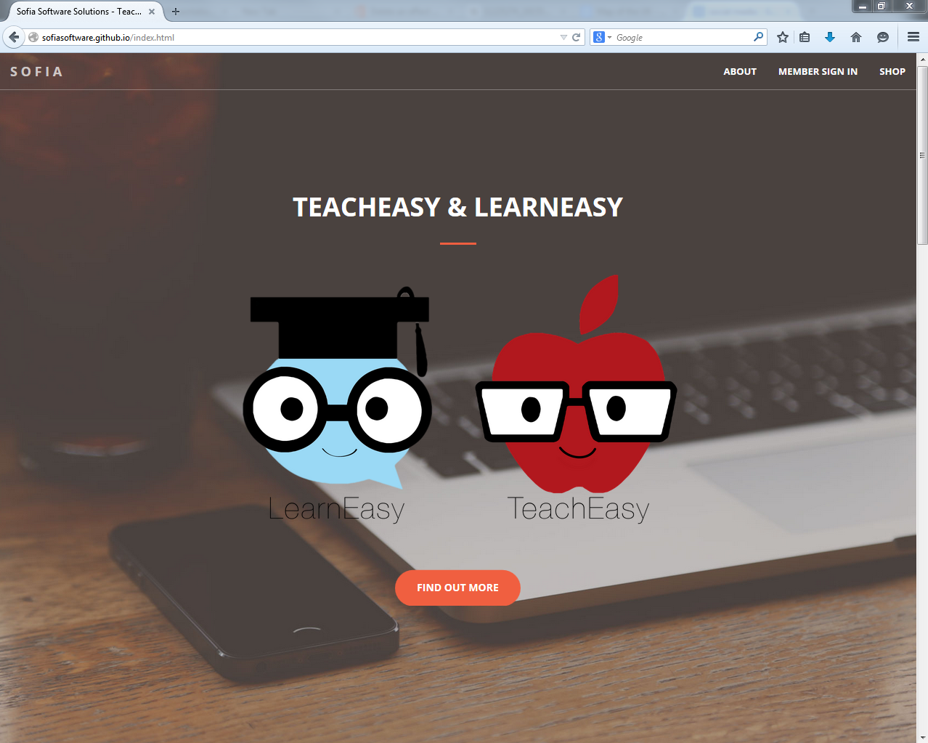
Advertisment
Currently hosted at:
www.sofiasoftware.github.io
FREE TRIAL

Slide 33
Financial Projections

Slide 34
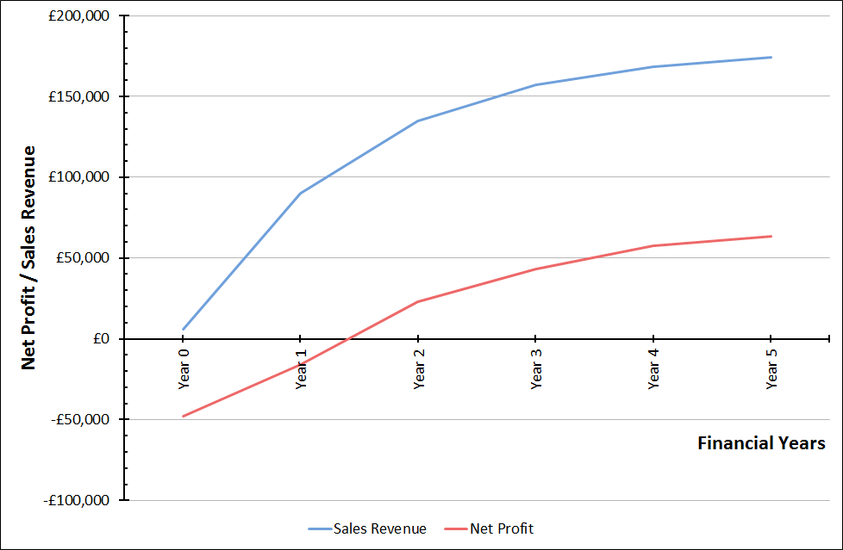
Approximate Net Profits
Year 1: -£16,000
Year 2: £23,000
Year 3: £43,000
Year 4: £57,000
Year 5: £63,000

Slide 35
Repaying the loan
Loan repayments:
End of Year 2 (Jul 2016 – Jul 2017): £15, 000
End of Year 3 (Jul 2017 – Jul 2018): £40, 000
End of Year 4 (Jul 2018 – Jul 2019): £10, 000
Total: £65, 000

Slide 36
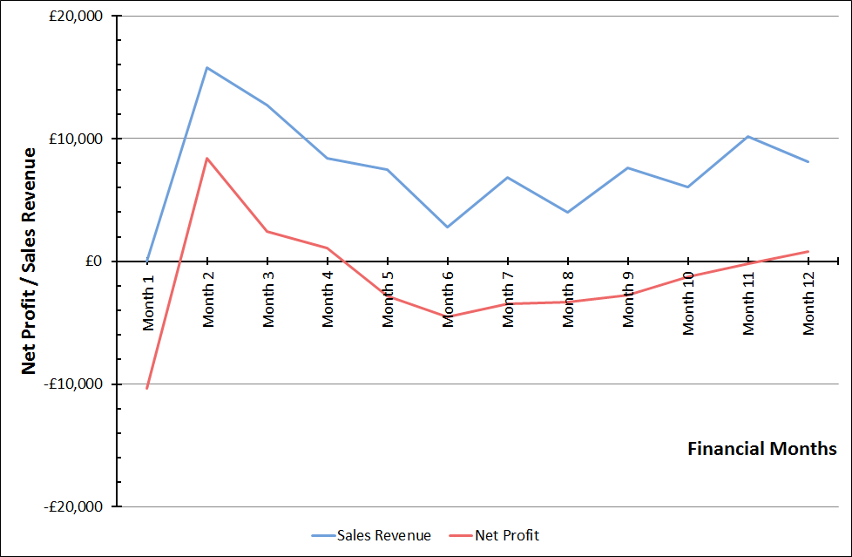
Year 1 - Net Profit and Sales Revenue
Notes:
A graph.

Slide 37

Percentage Total Market Penetration
Market Penetration | Year 1 | Year 2 | Year 3 | Year 4 | Year 5
Teachers | 0.72% | 1.07% | 1.25% | 1.34% | 1.39%
Tutors | 0.15% | 0.22% | 0.26% | 0.27% | 0.28%
Total | 0.65% | 0.97% | 1.14% | 1.22% | 1.26%
60% of Secondary Schools
31% of schools

Slide 38
Future Considerations

Slide 39
Current Implementation

Slide 40

Future Implementation
Class 2
Class 1

Slide 41
Thank you!

